Slide 1
Introduction to psychology
History– Lecture 9
Types of perception
Habib Ullah qamar
Mscs(se). MBA(HRM)

Slide 2

perception
Perception is compound, complex and creative mental process which function in understanding and adjustment.
It is an active mental process which organizes sensory information and experience in a meaningful form.
Sensation is a passive mental process related to external stimuli not to learning and experience.
Sensations do not change while perception may change according to the past learning and thinking.
Different people may have different perception to same stimuli.

Slide 3
Types of perception
Object / Form Perception
Depth and space perception
Perception of movement
Perception of time

Slide 4
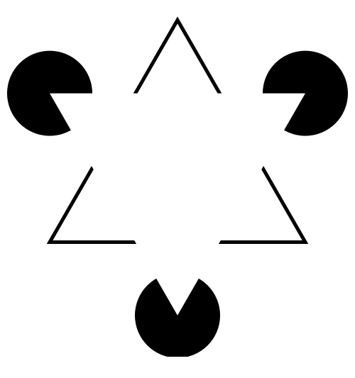
What are these shapes.

Slide 5
Form perception
It depends on sensory information, different forms and patterns are perceived. Real World vague and indistinct objects found
The subject narrows his perception and divide it into figure and grounds.
An object which is selected and attracted by the subject and become the center of his attention is called a figure.
Other figures are grounds which are not attended or focused by him. It depends on Figures and grounds.

Slide 6

Another puzzle
Figure and grounds

Slide 7
Perception Organization
As we learn in our previous experiment that perception dependes on sensory information. The process of finding Figure and grounds on the basis of sensory information is called perception organization. It is based on two things:-
1. Figure :- an object which is in the foreground, which is selected and attracted by the subject and become the center of his attention.
2. Other part of the an object is called background. Foreground might be bigger than foreground or may be equal in size.

Slide 8
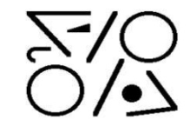

What is Gestalt
Gestalt is a German word. Meaning is configuration or, more simply, an organized whole in contrast to a collection of parts. When parts identified individually have different characteristics to the whole.

Slide 9
Gestalt school of psychology
Founded by Koffka, Kohler and Worthiemer
They stated that visual field consists of both figures and grounds.
Gestalt mean organized whole
Followers of Gestalt school of thought emphasized on tendency of integration of pieces of information into meaningful wholes.
They stated that First we perceive a thing as a whole and then go into pieces.

Slide 10
Perception Organization
Law of nearness : things nearer to each other makes figures
Law of similarity or likeness : similar objects are group and perceive accordingly
Law of good form : stimuli having similar shapes are grouped together

Slide 11
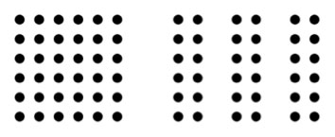
Law of nearness
Things situated nearer to each other form a pattern or figure. We perceive in a moment

Slide 12
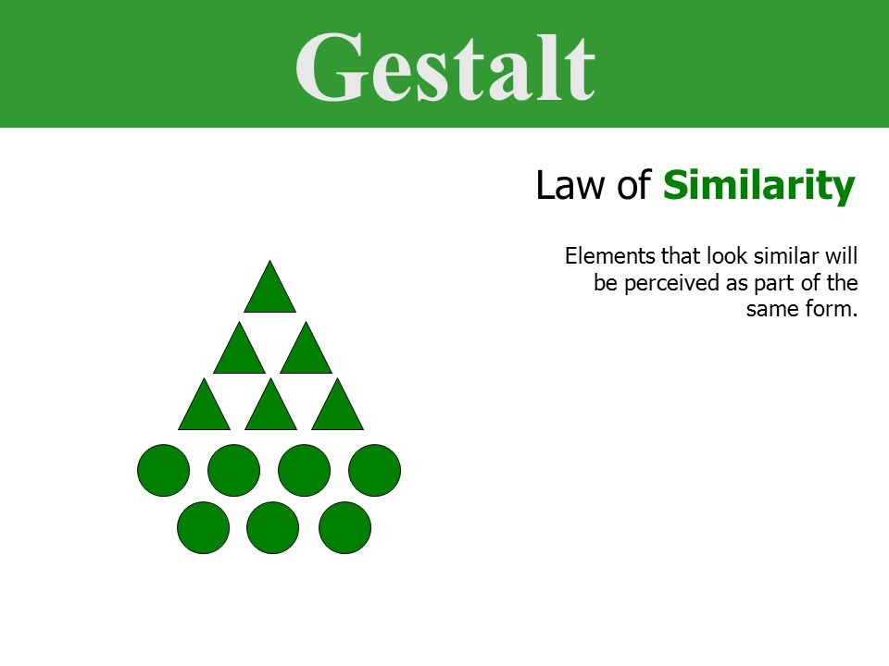
Law of similarity or likeness
Tendency of group together similar elements

Slide 13
Law of good form
Stimuli having similar shapes are grouped together
This grouping may be of five types
  Good continuation
  Symmetry
  Closure
  Common direction
  Inclusiveness

Slide 14
Law of good form
Stimuli having similar shapes are grouped together
This grouping may be of five types
  Good continuation
  Symmetry
  Closure
  Common direction
  Inclusiveness

Slide 15
Good communication
Tenancy to see all the parts of a figure as a whole

Slide 16
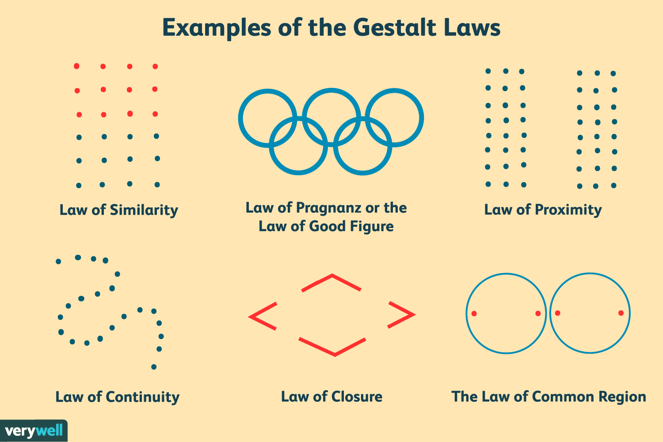
Quiz

Slide 17
Study material
Chapter 4 – Prof. Zarin Bukhari
TheITeducation.com

Slide 18
Thanks ……
Habib ullah qamar

